Slide 1
Kennebec River near Augusta, ME
Ice Jam Flooding January 26th, 2010

Slide 2
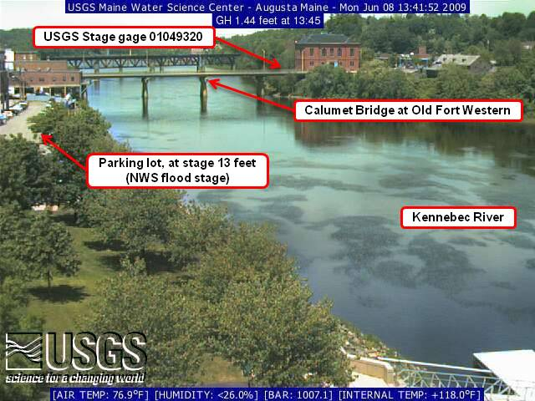
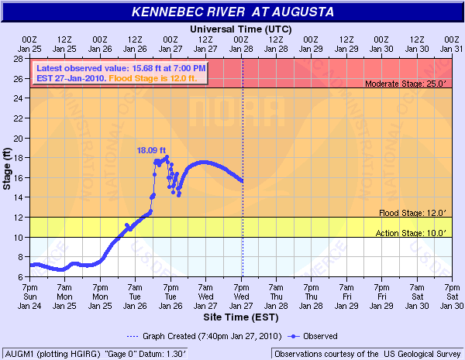
Still shot of location

Slide 3
Kennebec River at Augusta, ME

Slide 4
Kennebec River at Augusta, ME

Slide 5
Kennebec River at Augusta, ME

Slide 6
Kennebec River at Augusta, ME

Slide 7
Kennebec River at Augusta, ME

Slide 8
Kennebec River at Augusta, ME

Slide 9
Kennebec River at Augusta, ME

Slide 10
Kennebec River at Augusta, ME

Slide 11
Kennebec River at Augusta, ME

Slide 12
Kennebec River at Augusta, ME

Slide 13
Kennebec River at Augusta, ME

Slide 14
Kennebec River at Augusta, ME

Slide 15
Kennebec River at Augusta, ME

Slide 16
Kennebec River at Augusta, ME

Slide 17
Kennebec River at Augusta, ME

Slide 18
Kennebec River at Augusta, ME

Slide 19
Kennebec River at Augusta, ME

Slide 20
Kennebec River at Augusta, ME

Slide 21
Kennebec River at Augusta, ME

Slide 22
Kennebec River at Augusta, ME

Slide 23
Kennebec River at Augusta, ME

Slide 24
Kennebec River at Augusta, ME

Slide 25
Kennebec River at Augusta, ME

Slide 26
Kennebec River at Augusta, ME

Slide 27
Kennebec River at Augusta, ME

Slide 28
Kennebec River at Augusta, ME

Slide 29
Kennebec River at Augusta, ME

Slide 30
Kennebec River at Augusta, ME

Slide 31
Kennebec River at Augusta, ME

Slide 32
Kennebec River at Augusta, ME

